Slide 1

Go Outside, Innovate yourself, Inspire the world.

Slide 2
Team Members :
Aliaa Halim Open Source
Hager Hussien Open Source
Mai Mohamed Open Source
Mohamed Baghdad Open Source
Mohamed Shehata Open Source
Sara El Driny User Interface
Team Leader:
Mai Mohamed
Supervised by:
Eng/ Noha Salah

Slide 3
OutLine
Introduction:
- Problem.
- What’s Rubyera ?
- Goal and Objective.
Customer Analysis.
Competitor Analysis.
SWOT Analysis.
Business Model.
Beneficiaries & Stakeholders.
Project Progress.
Demo.
Future Work.

Slide 4
Problem
There is a weak link between the customer and the providers of the Photography, Videography and Script Writing services.
Many talented photographers for example, who provide good service with low budget, aren't well known in the community.
On the other hand, Customers have variety of service demands whether it’s according to their budget or to the level of quality

Slide 5
What is Rubyera ?

Slide 6
Goal :
Making Rubyera one of the most used platforms in the Media field.
Objectives:
Launch Rubyera within 2nd quarter of 2017.
Downloads 450 after one year.
Traffic 30,000 after one year.
We intend to expand our market to the Gulf area
Events

Slide 7
Customer Analysis

Slide 8
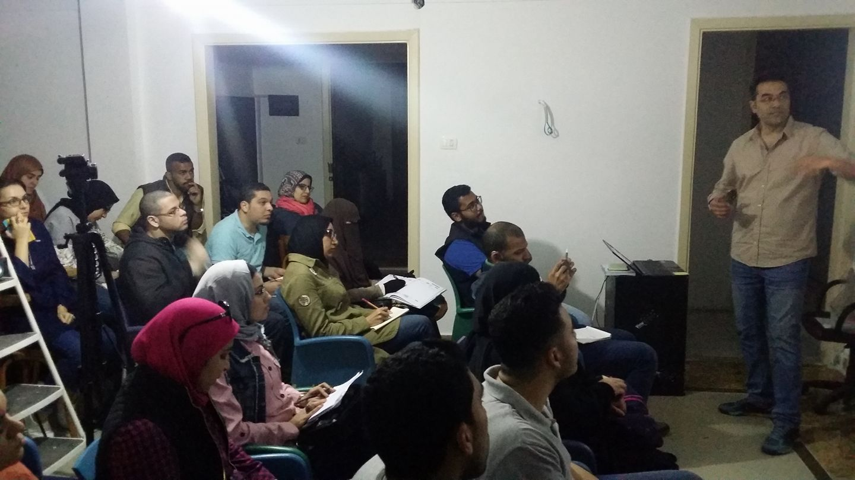

Slide 9
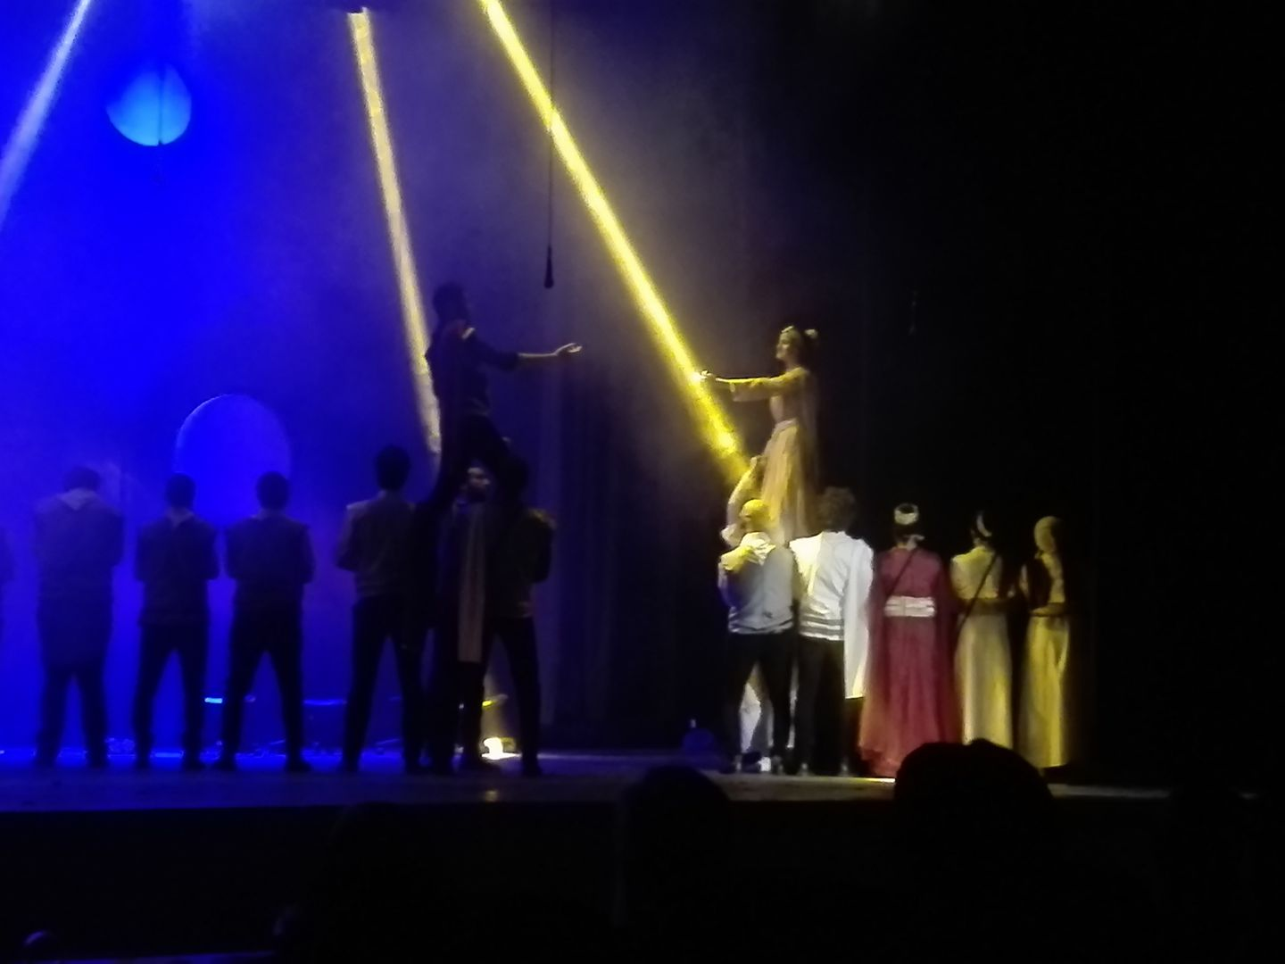
قصر ثقافة الأنفوشى - العرض المسرحى "كاليجولا“

Slide 10
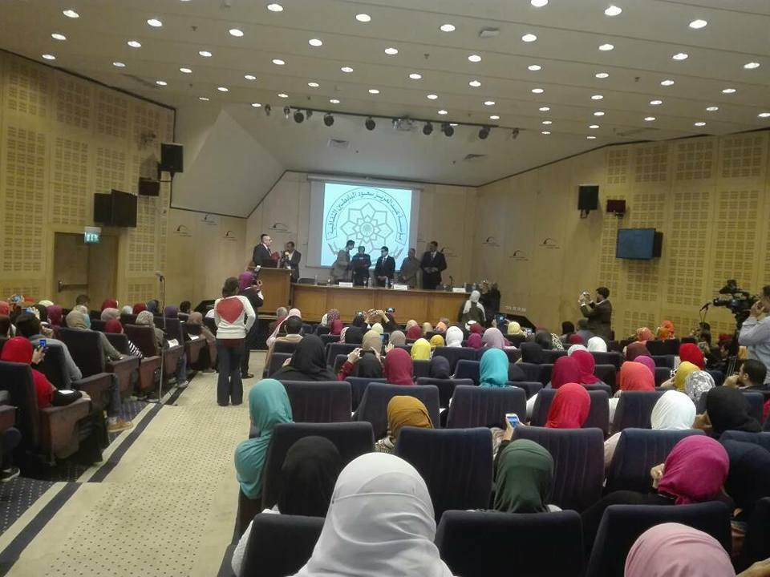
جائزة عبد العزيز سعود البابطين للشعر العربي بالتعاون مع إذاعة صوت العرب - مكتبة الأسكندرية

Slide 11
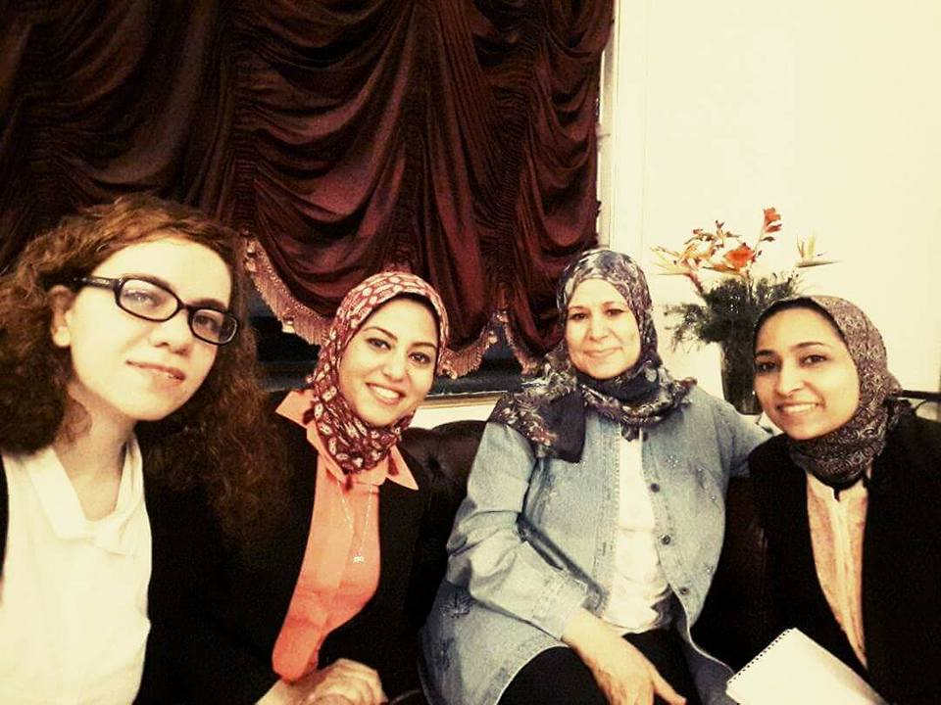
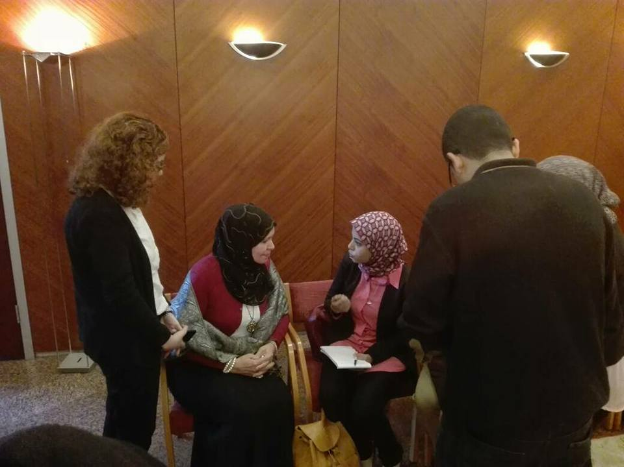
لقاء مع الصحفية بجريدة الاهرام : تهانى صلاح

Slide 12
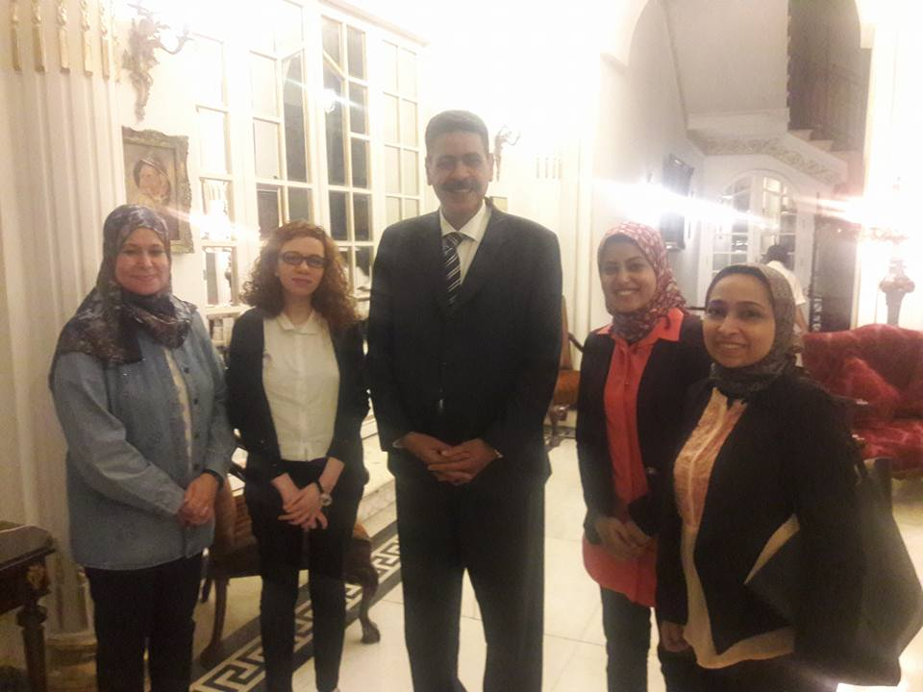
لقاء مع الاستاذ : جمال حماد مدير اذاعة صوت العرب

Slide 13
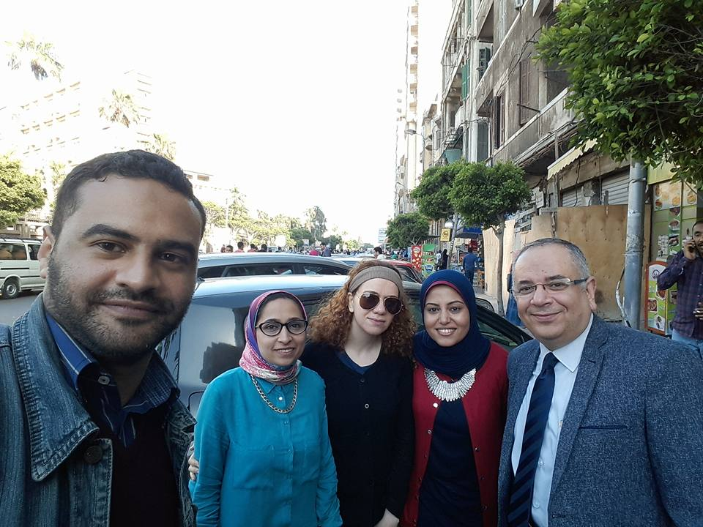
لقاء مع الاستاذ : حسام عبد القادر المستشار الاعلامى لمكتبه الاسكندرية

Slide 14
نادى عدسة
الكاتب محمد غنيمة
مساعد رئيس تحرير جريدة حواء : حنان هزاع

Slide 15
Ages:
from 20 to 40.
Location :
Cairo.
Alex.
Classes:
A and B .

Slide 16
Social Network

Slide 17



Competitive Analysis

Slide 18
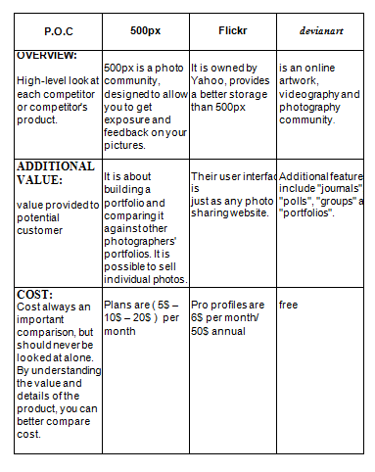

Slide 19
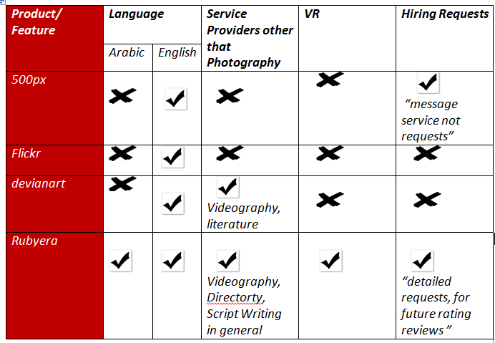

Slide 20
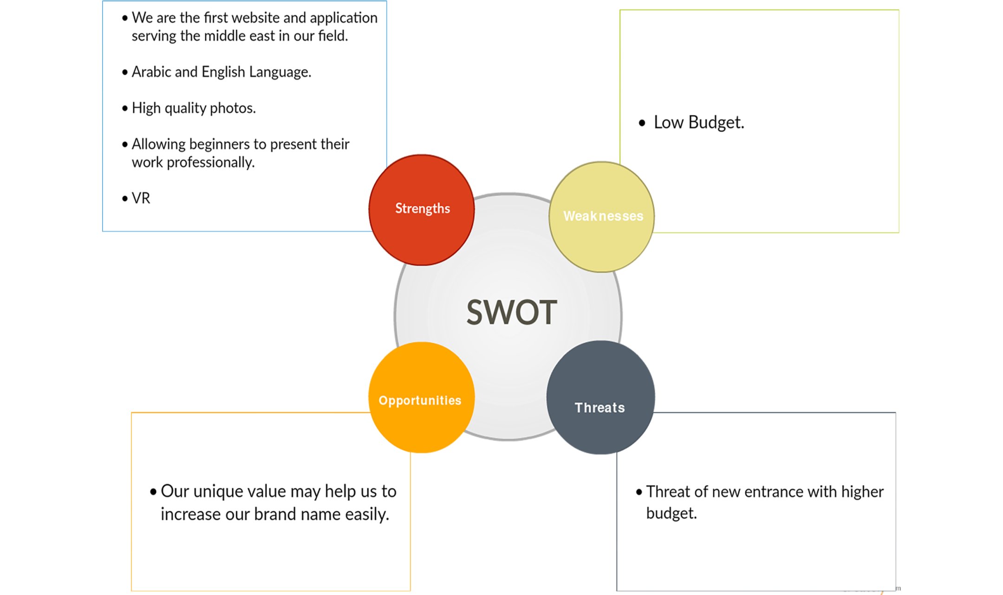

Slide 21
Business Model

Slide 22




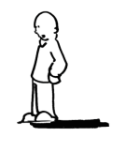
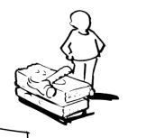



Business Model Canvas => Rubyera
Key Partners We’ve built relations with Public figures who in turn introduced us to more figures related to the core of our application , showed great support , and still giving us advice to raise the value of our product. We’ve also made social media accounts on Facebook, twitter and Instagram which could be the start to attract more audience till we grow up and reach the Branding Phase. | Key Activities API based project where: Laravel handles the Backend. Angular JS for the Frontend UI,UX design Ionic for a cross platform mobile application. | Value Propositions Helping young talents to present their work on our platform where each Category provided in our application gets a fair competition between each other. Customers have variety of service demands whether it’s according to their budget or to the level of quality. |  | Customer Relationships Maintaining a good relationship with the consumers by sending greetings emails, offering valuable tips to help the user in improve his skills, offering discount on the membership for regular users. | Customer Segments Most of our segment are in Cairo & Alexandria. Female ratio is 1 to 3 They are between A and B class. They are active on social media. Their ages are between 20 and 40 Most of them are interested in events and workshops in the field of cinema and photography
 | Key Resources Web server Service Providers Presence in live events related to the core of our application “Promoting our product” |  |  | Channels Trusted public figures. Social media Ads , SEO , ASO and email. Constant presence in live Events related to the core of application.
Cost Structure Host: $125 Domain: $13 Ads - social media: $150 |  |  | Revenue Streams Monthly/yearly Packages for online storage. Fees for handling secured online payment for services Ads for products and brands.

Slide 23
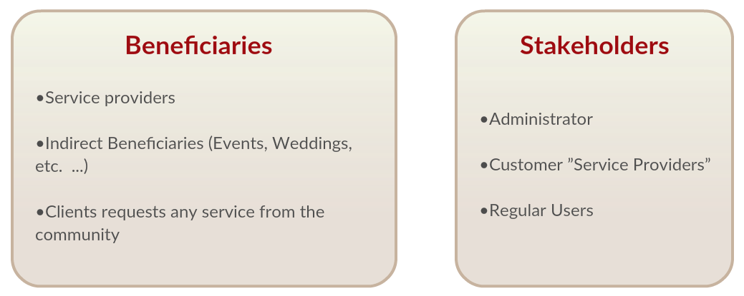

Slide 24
Project Progess

Slide 25


Logo Concept
Colors

Slide 26


Slide 27
Wireframe

Slide 28
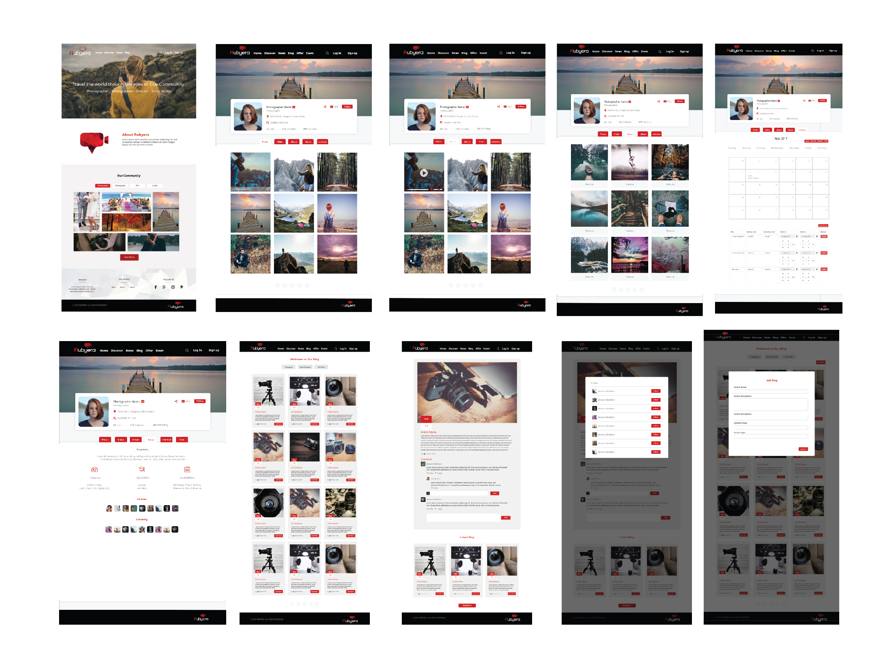

Slide 29
Tools & Technologies:
Design:
Adobe Photoshop
Adobe Illustrator
Adobe Experience Design (Adobe XD)
Front-End:
AngularJS ( JavaScript Framework )
Back-End:
Laravel ( PHP Frameeork ) , Restful API

Slide 30
Cross-Platform:
Apache Cordova
Ionic
Third-Part:
Google VR
Testing Tool:
Postman

Slide 31
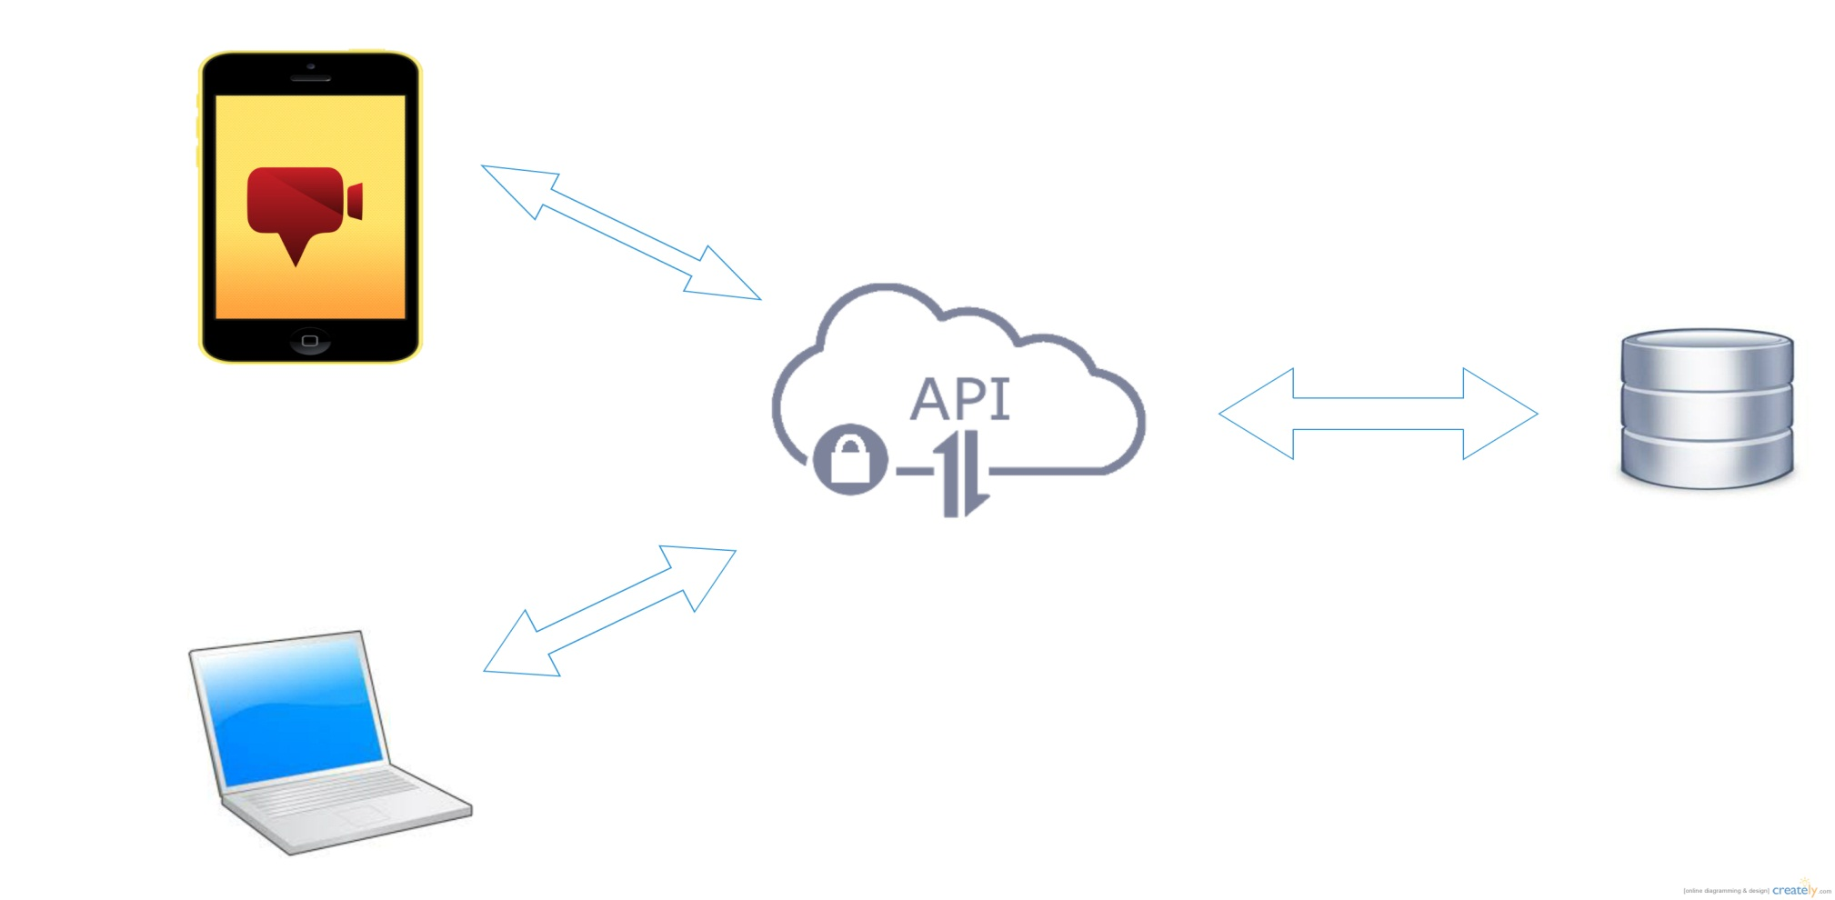
System Architecture

Slide 32
Demo

Slide 33
Future work
Releasing IOS version.
Online Payment.
Code will be refactored.
Hiring Q.C team, experienced P.O.

